Slide 1
How to play
Cyber Space Odyssey
Mr. James Anderson
Dr. Scott Nykl
24 July 2023

Slide 2
Story
A spy has recently discovered a terrorist plot to cripple the U.S. military by destroying their top academic institution: the Air Force Institute of Technology. Central to this diabolical scheme is a plan for an undercover agent working on one of five space stations to hijack the station and use it to breach AFIT security systems. Although unable to identify the rascal, the spy was able to confirm that further incriminating information might exist on the space stations themselves. The government has therefore offered a substantial reward to the first person to bring them the rogue operative, accompanied by sufficient evidence to convict him or her in a court of law. You happen to be a technically talented bounty hunter with a spaceship, so this is the perfect job for you. Your plan is to infiltrate the private network of each space station in order to collect the necessary evidence to identify and convict the miscreant. Be quick, though; you are not the only bounty hunter pursuing such a handsome reward . . .

Slide 3

Game World
Notes:
The game world looks like this, with five different space stations orbiting the earth.

Slide 4
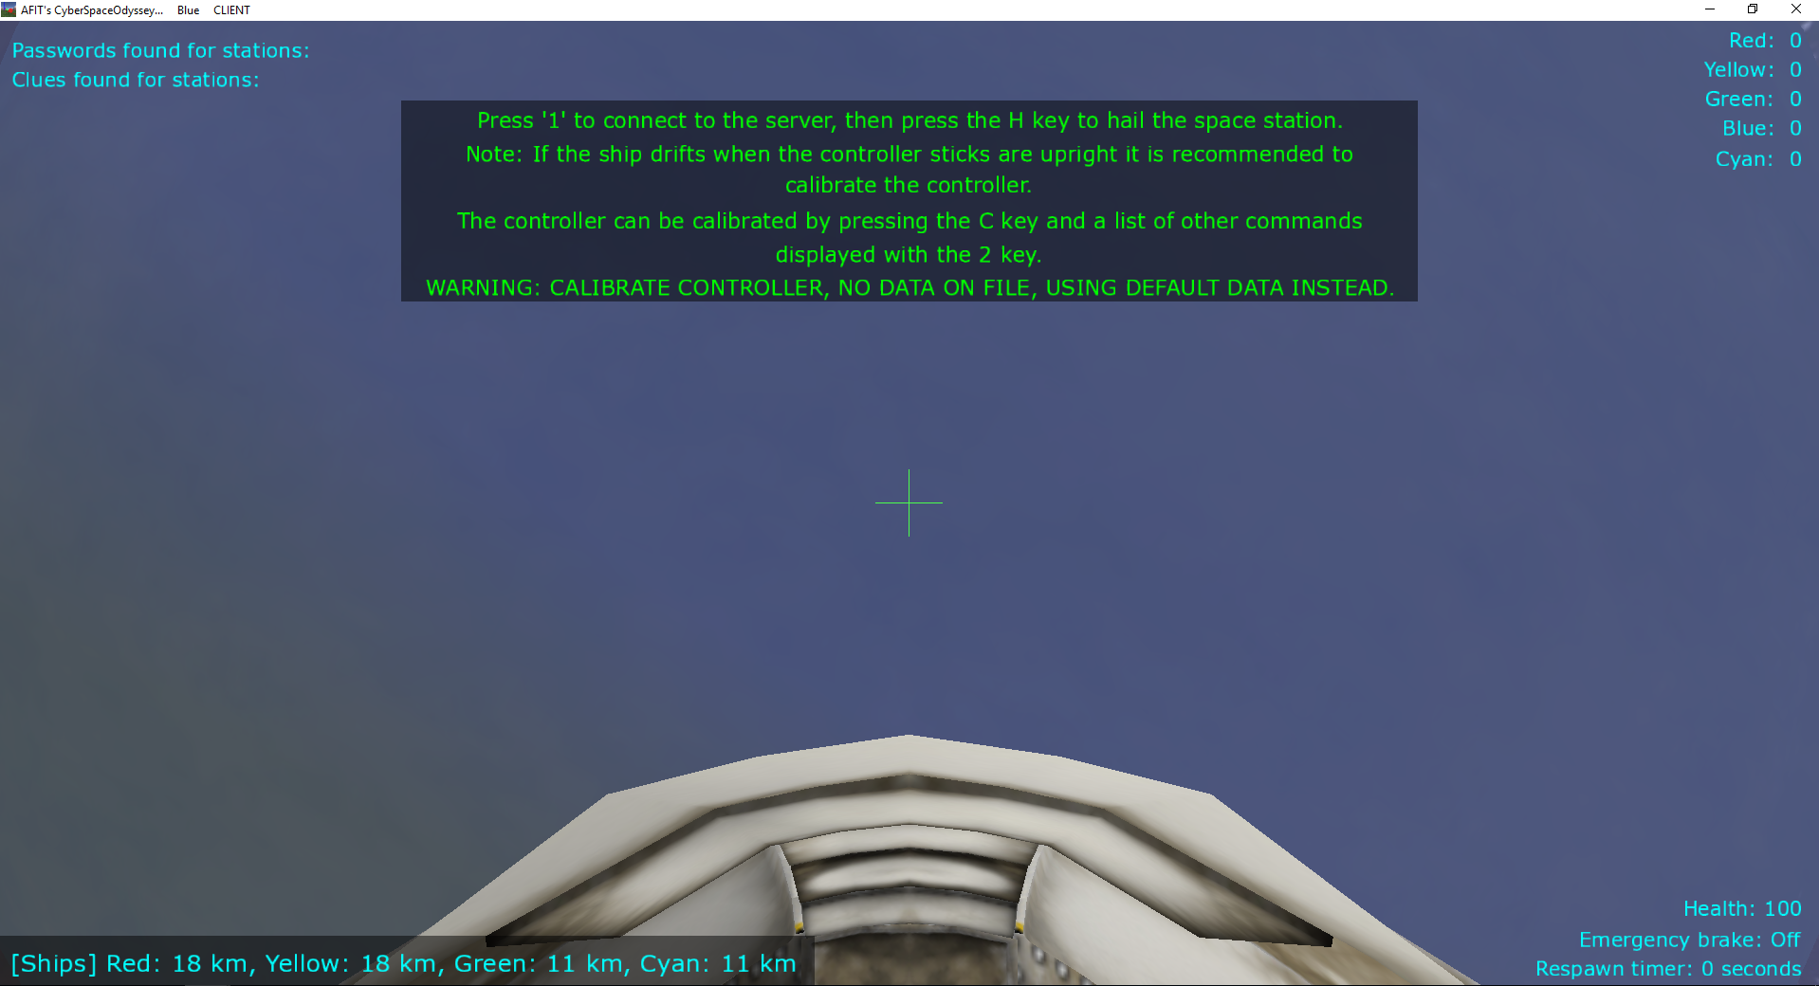
Game World
Notes:
Players view the world from a cockpit. The upper left-hand corner shows their game progress. The upper right-hand corner shows the current ranking of the five teams. The bottom left-hand corner shows the player’s distance from other spaceships. The bottom righ-hand corner shows the player’s health, emergency brake state, and the respawn timer upon dying.

Slide 5
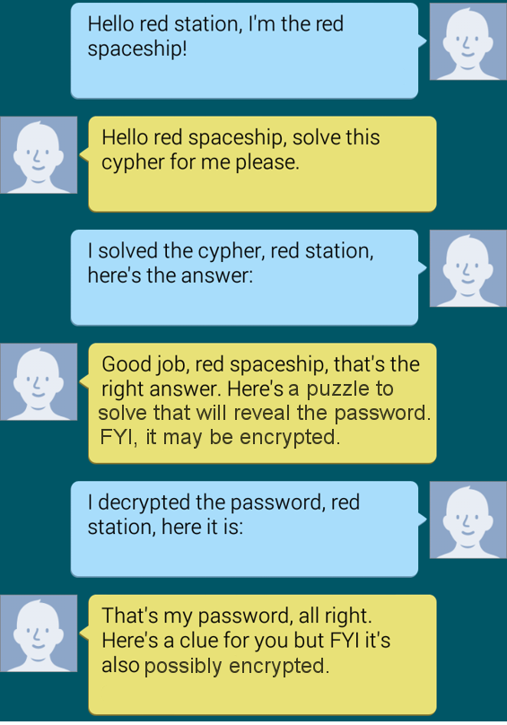
Obtaining Clues
Fly to each of the five space stations and hold a conversation with the server. The server will send network packets for you to find on Wireshark, and you will send your own network packets to the server in response. If the conversation is successful, you will earn a clue.
Notes:
Players will have a conversation like the one above, where they will craft UDP packets and send them to the server, and the server will transmit UDP packets for the client to find. Frequently, the server will send the necessary packet directly to the client, but sometimes the server sends a packet to somebody else and the client has to eavesdrop.

Slide 6
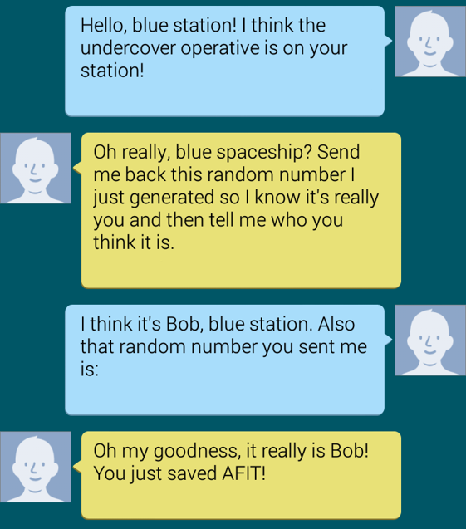
Making an Accusation
Once you have obtained a clue from each space station, use them to figure out who the undercover operative is. Fly to the operative’s space station and hold another conversation with the server to apprehend him (or her).

Slide 7
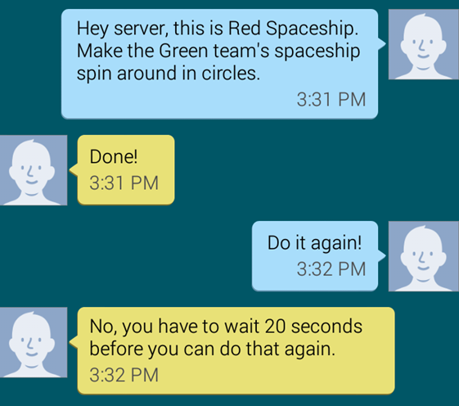
Just for fun: Hacking other spaceships
Every spaceship has a team state that influences its motion.
You can tamper with this by sending hacks to the server.
Hacks last 20 seconds.
Each team can only send 1 hack every 20 seconds.
Must be within 5 km of the target team.
Each ship also comes equipped with a laser that disables ships for 15 seconds if their health reaches 0.

Slide 8




Scoring
You earn points for every successful packet you send to the server, and you earn more points for something if you do it before another team.
You lose points for making an incorrect accusation. There is no other possible way for you to lose points.

Slide 9
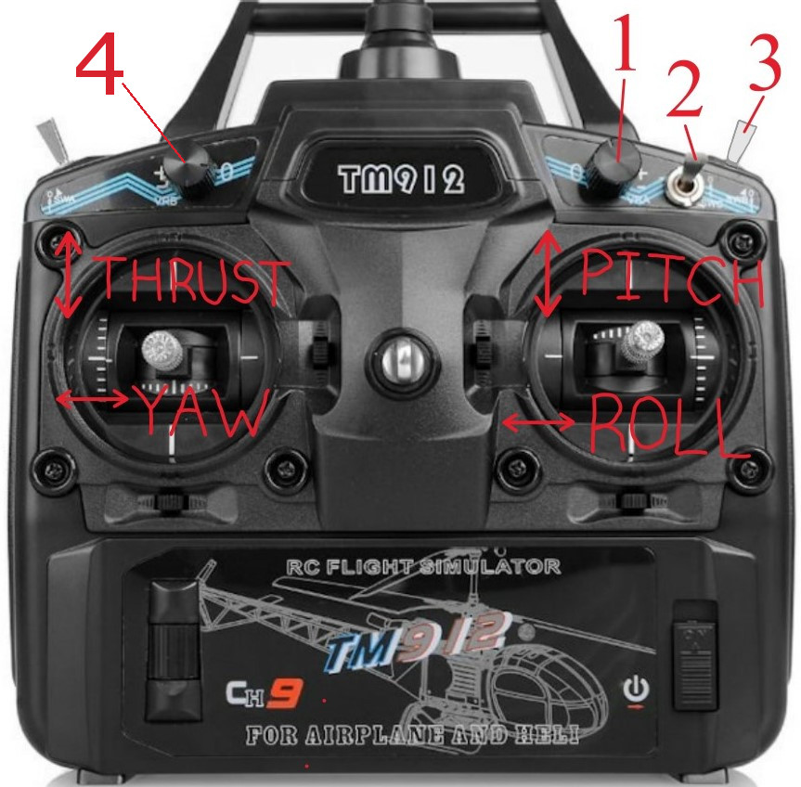
Flying the Spaceship
Laser shooter
Emergency brake
Windshield wipers
Laser shooter
Notes:
You can't fly into the planet, it kills you. When you die, you go back to your space station and are unable to move for 30 seconds (which is super annoying, trust me.) The self-destruct button kills you. The emergency brake disables the thrust, but you can still rotate. It's off when you start the game, and toggling the switch turns it on and off. Whichever way it points when you start the game means off. You've noticed the green messages that print to your screen; the windshield wipers get rid of these. They can't come back, so don't delete them. The laser shooter turns the laser on if turned clockwise and turns off if turned counter-clockwise. This lets you disable the joystick’s controls if you do enough damage to an opponent’s ship. Don't turn the joystick off because you have to have the switches and things set up a certain way in order for it to work properly.

Slide 10
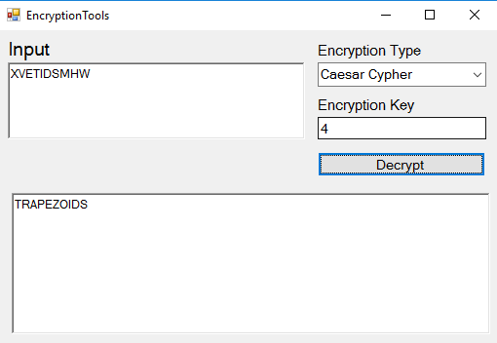
Decrypting Clues
Whenever a password or clue is received from a station EncryptionTools may be necessary to decrypt it.
Some passwords are encrypted using a Caesar Cypher. Some are also prime number or Base64 encrypted.
Some clues are encrypted using a Substitution Keyword Cypher and some are Base64 encrypted.
Use the clues to solve the mystery
Notes:
(is this info still relevant?) When the station sends passwords and clues, they’re usually encrypted. The program automatically writes them out to a file which is then read by EncryptionTools. Using it is very simple: Load Data brings in the most recent data received from the server. Decrypt uses whatever data it has loaded to decrypt as much as it can, like you see here. The notes section makes it easier to see all the clues at once. If your data somehow gets corrupted or you lose it, pressing the number '2' makes the server resend everything to you.

Slide 11
Using Wireshark
A lot of packets get sent continuously over the network, and you can see everything that is sent to everyone.
Use filters in Wireshark to find the specific packet you’re looking for.
Filters are boolean expressions that can be combined using parentheses along with && and || operators.
Boolean expressions include
udp
ip.src == 192.168.225.105
ip.dst == 192.168.225.105
data.len != 128
data contains 19:c0:78:0e
data contains “spaceship”
Notes:
Helpful for debugging, but mostly helpful to read the station cypher that comes after sending a hail message. A lot of packets get sent back and forth, so you’ll want to filter them.

Slide 12
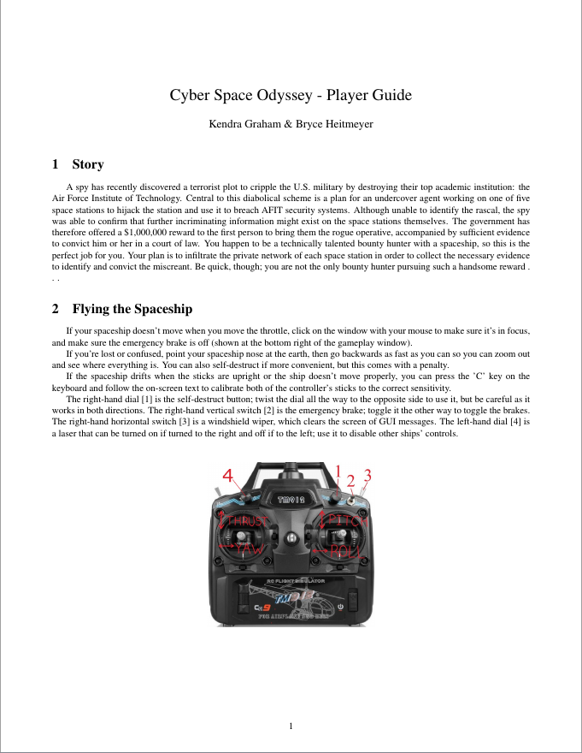
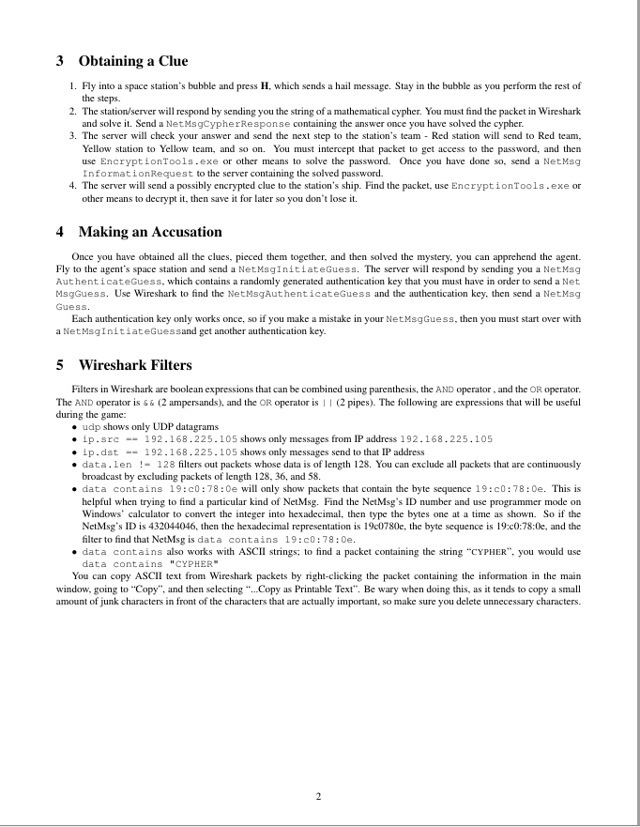
Notes:
This is the reference sheet you’ll have as you play the game. These two pages give you tips about flying the spaceship, walk you through the process of obtaining clues and making accusations, and enumerate some Wireshark filters that will be helpful to you.

Slide 13
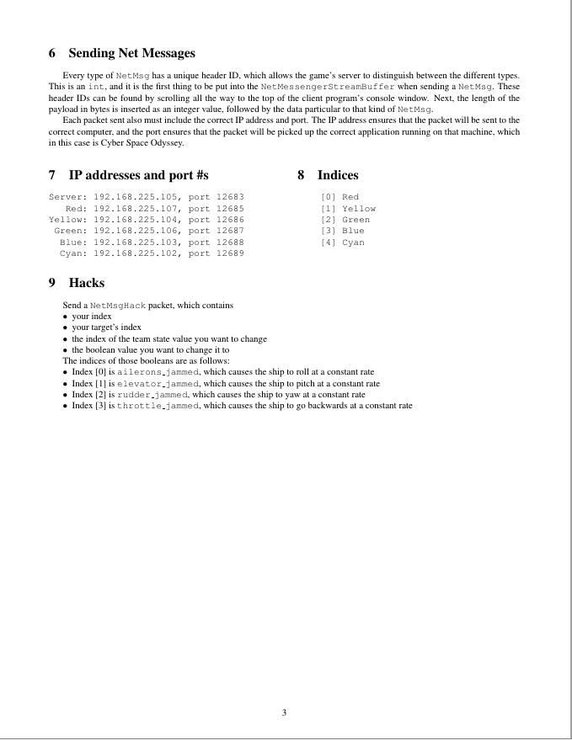
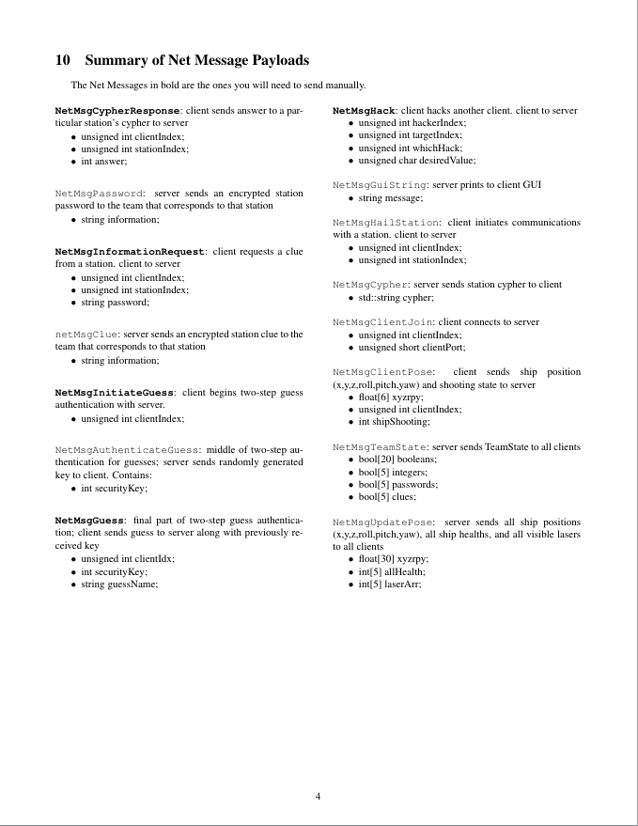
Notes:
These two pages tell you how to send hacks and give you a reference of the current IP addresses and port numbers of the players, as well as a reference of all the NetMsgs that are sent in the game and their data payloads.

