Slide 1
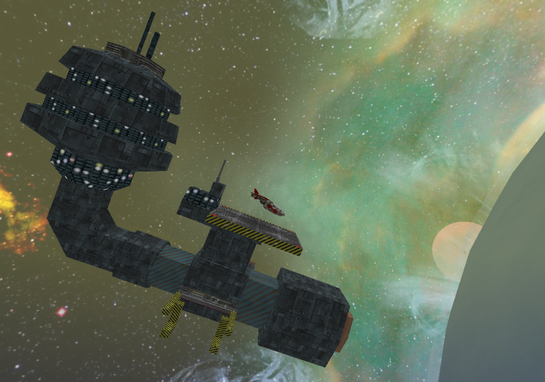
Engine
GLView
Manager Class
WO
Graphics Object
NetMsg
Game specific network packet
Game Module
GLViewCSO
Top-level manager class
Runs graphics, IO, and networking
NetMsgUpdatePose
NetMsgTeamState
Planet
NetMsgPassword
NetMsgInitiateGuess
Spaceship(s)
NetMsgClientJoin
NetMsgInformationRequest
NetMsgHailStation
GameState
Model class
TeamState
Model class
JoystickState
Model class
NetMsgGuiString
NetMsgClue
NetMsgAuthenticateGuess
NetMsgClientPose
NetMsgCypher
NetMsg
NetMsg
Hardware Input
NetMsgCypherResponse
NetMsgHack
NetMsgGuess

Slide 2
Server
Client
NetMsgClientJoin
NetMsgClientPose
NetMsgTeamState
NetMsgUpdatePose
NetMsgHailStation
NetMsgCypher
NetMsgCypherResponse
NetMsgPassword
NetMsgInformationRequest
NetMsgClue
NetMsgInitiateGuess
NetMsgAuthenticateGuess
NetMsgGuess
NetMsgGuiString
NetMsgHack

Slide 3
Server
Client
Ship Position
Ship Position
Ship Position
Ship Position
Ship Position
Ship Position
Ship Position
Ship Position
Ship Position
Ship Position
GameState
(includes info about teams’ progress and data about the mystery)
Player Actions
Informational Messages
Team State
(includes score and rankings)
Team State

