Slide 1
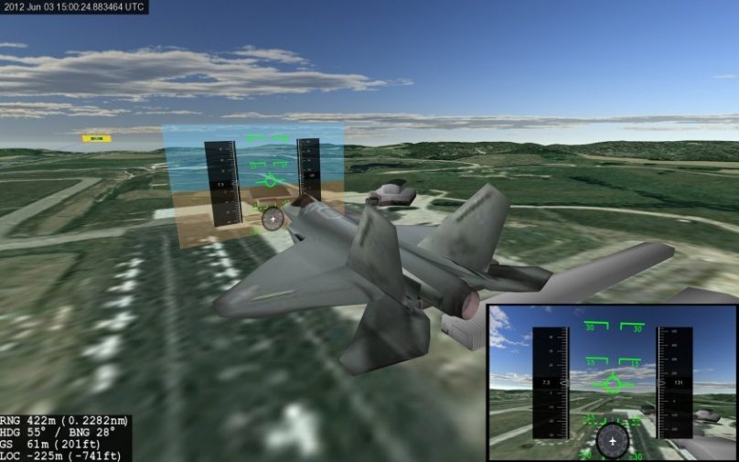
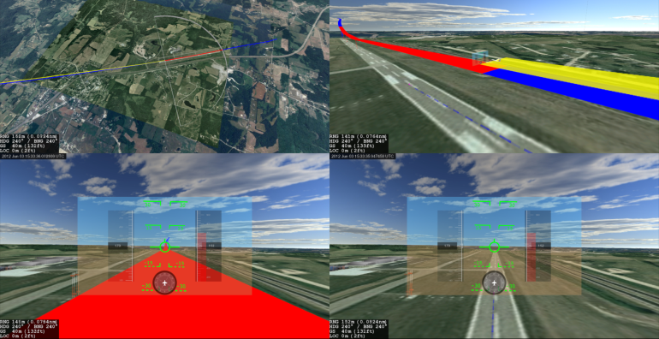
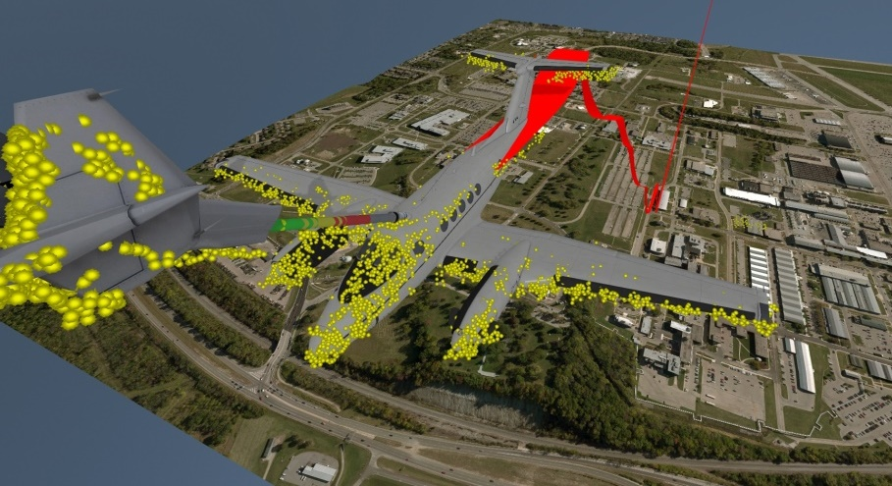
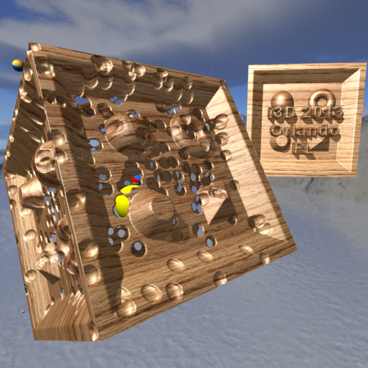
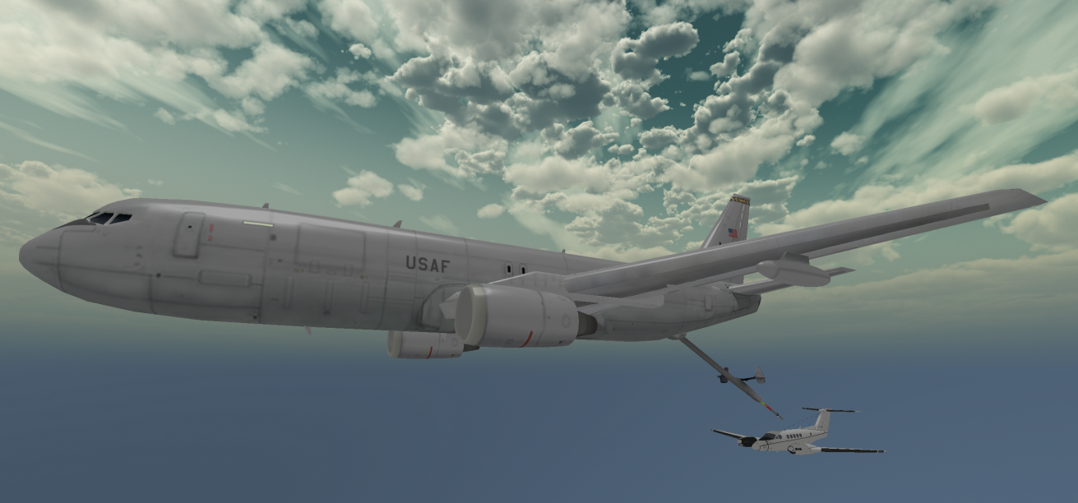
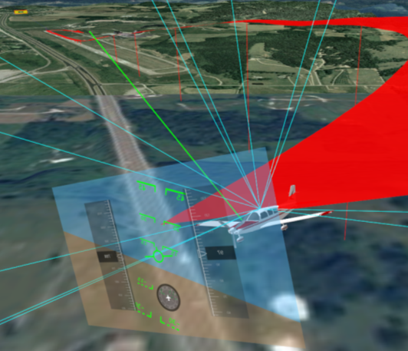
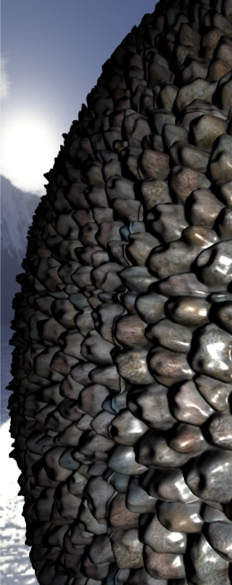
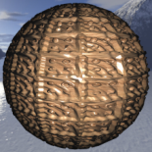
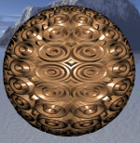
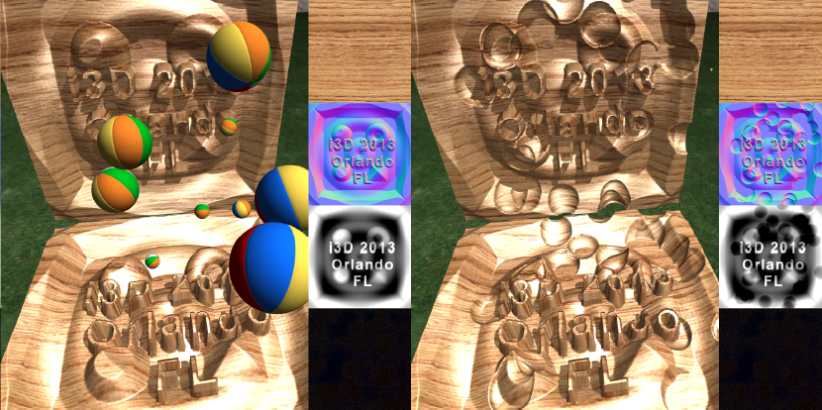
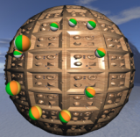
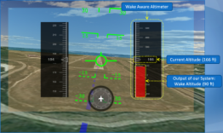
"Using 3D Digital Twins for Computer Vision Research and Cyber Education"
Air Force Institute of Technology (AFIT)
scott.nykl@afit.edu
Youtube.com/scottnykl
Dayton Digital Summit
12 May 2023
Dr. Scott Nykl

Slide 2
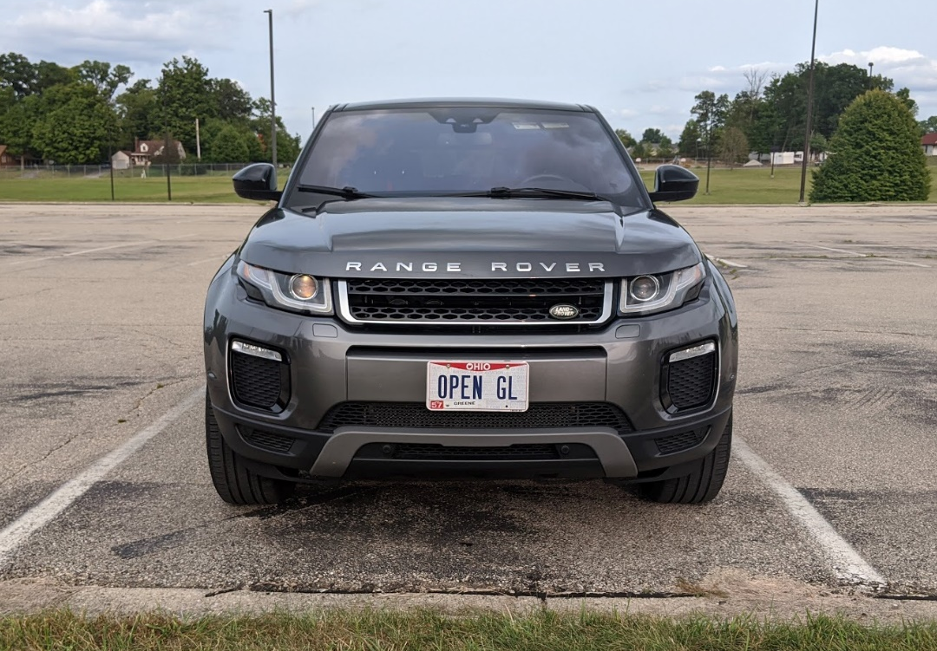
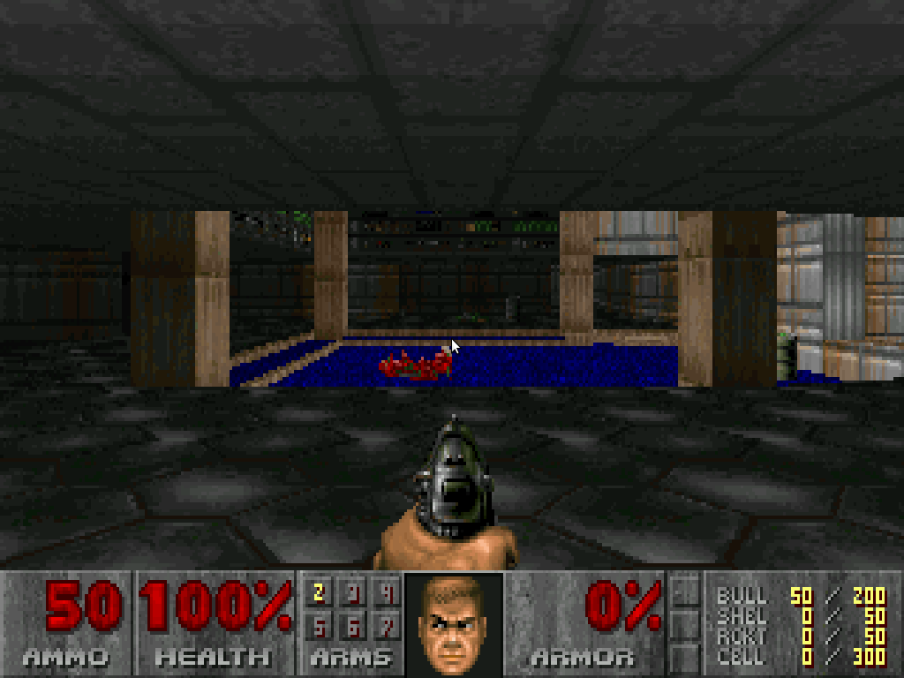
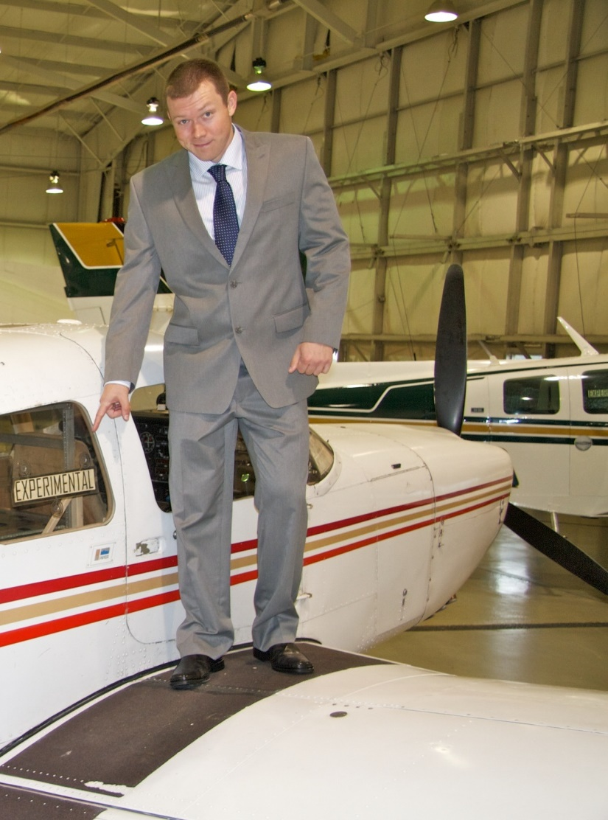
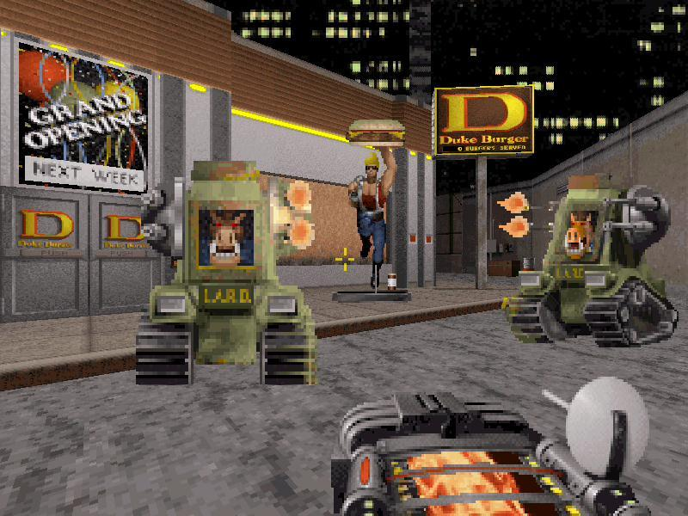
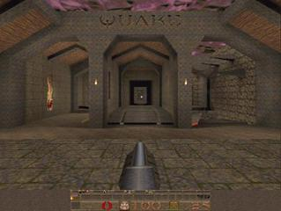
3D Graphics are Awesome.
Virtual Worlds are Powerful.
Notes:
o Downloaded from a Bulletin Board Service via Prodigy

Slide 3
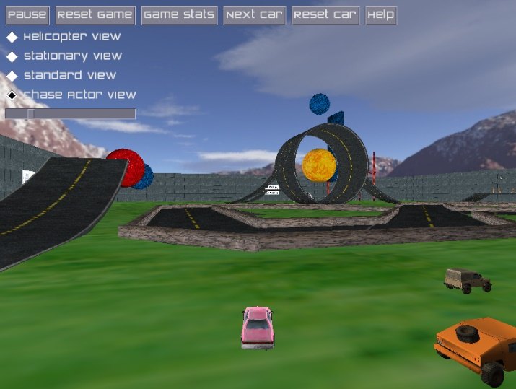
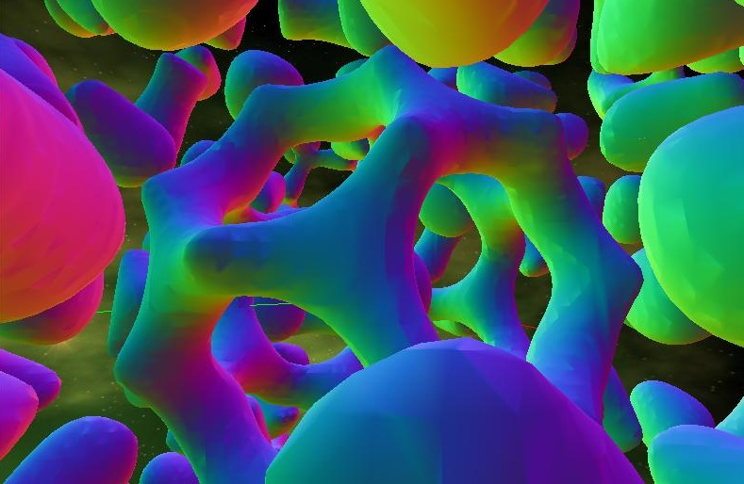
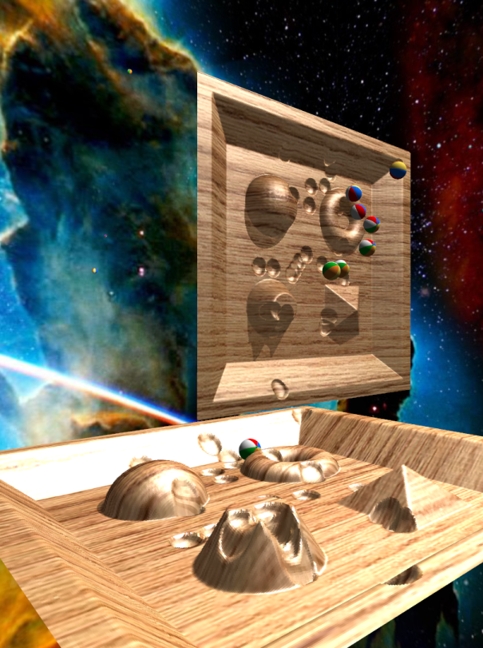
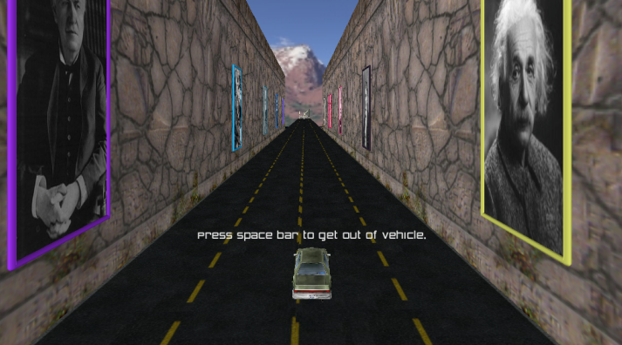

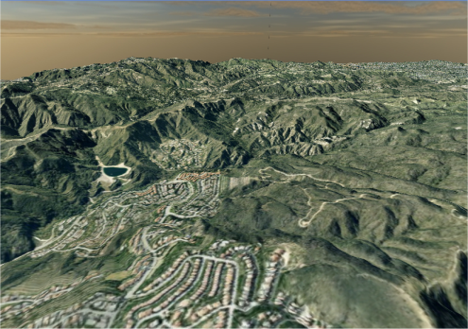
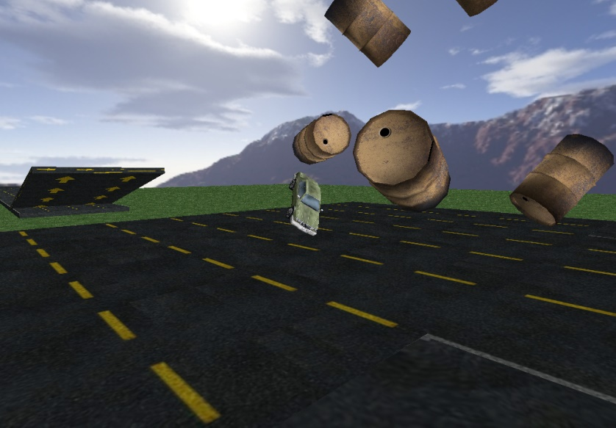
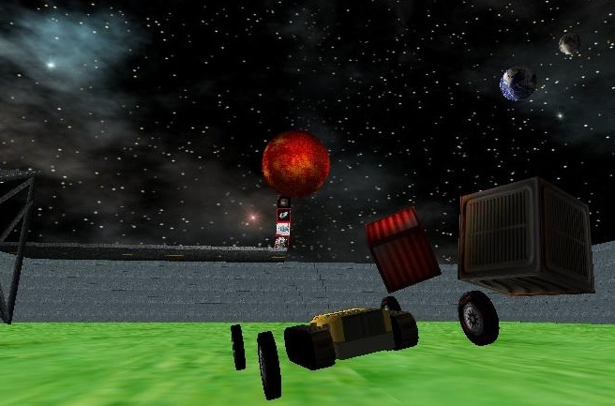
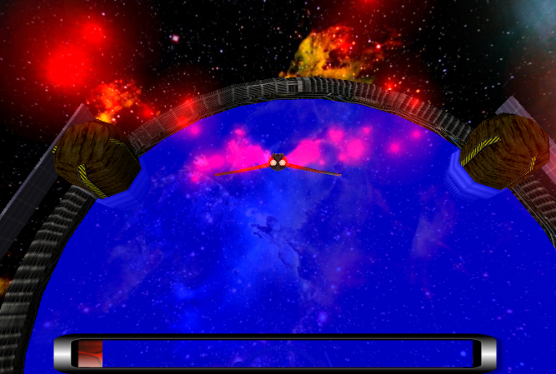
Visualization digests complexity, lets one absorb knowledge
Notes:
o present previous visualization work
o turn raw data into decision-ready knowledge
o discuss computer graphics rendering approaches to handle large amounts of data

Slide 4
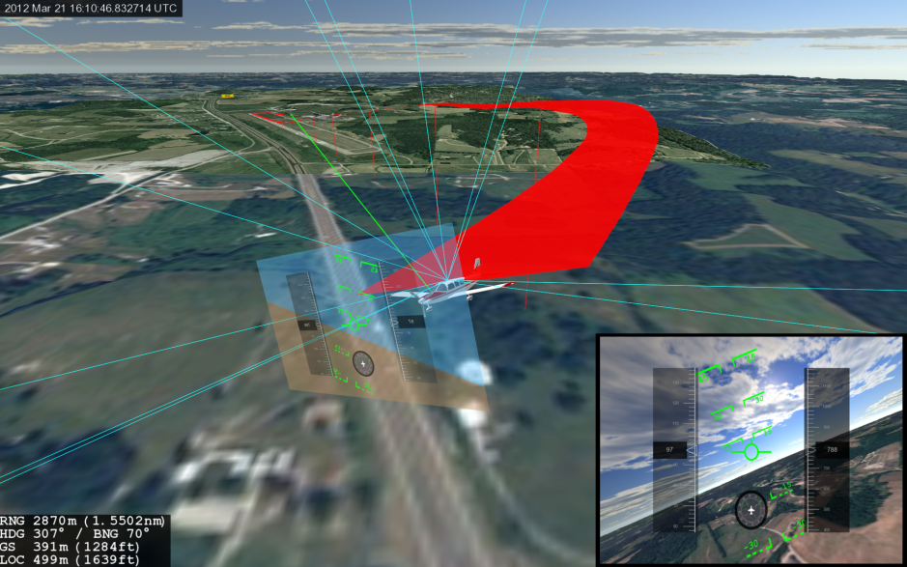
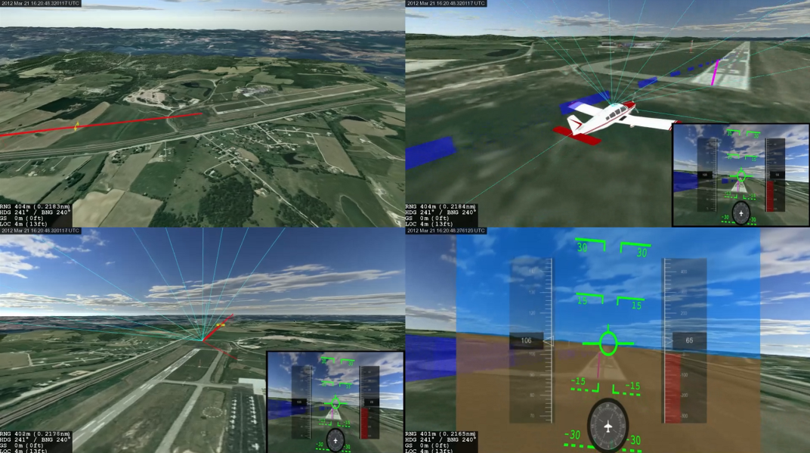
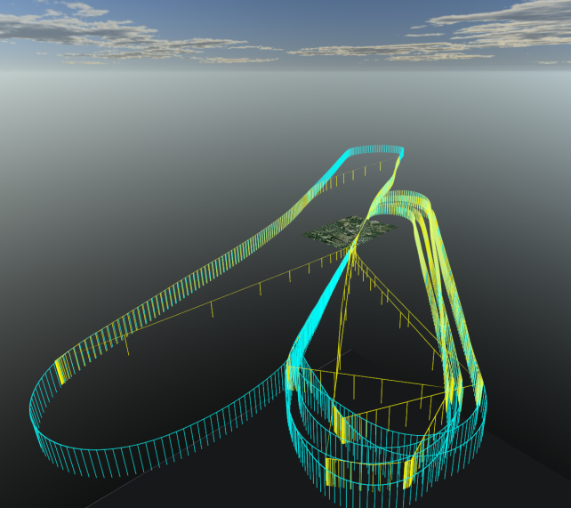
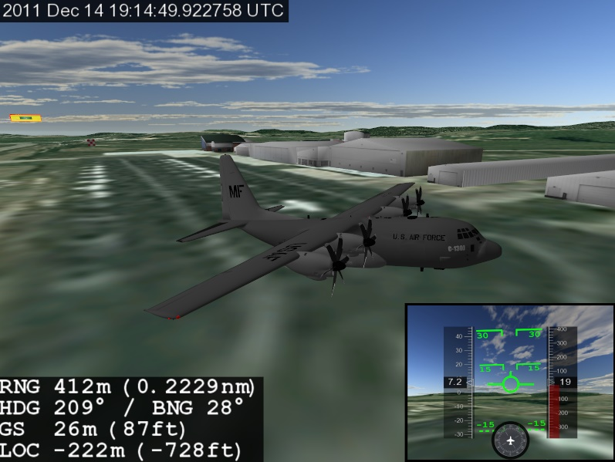
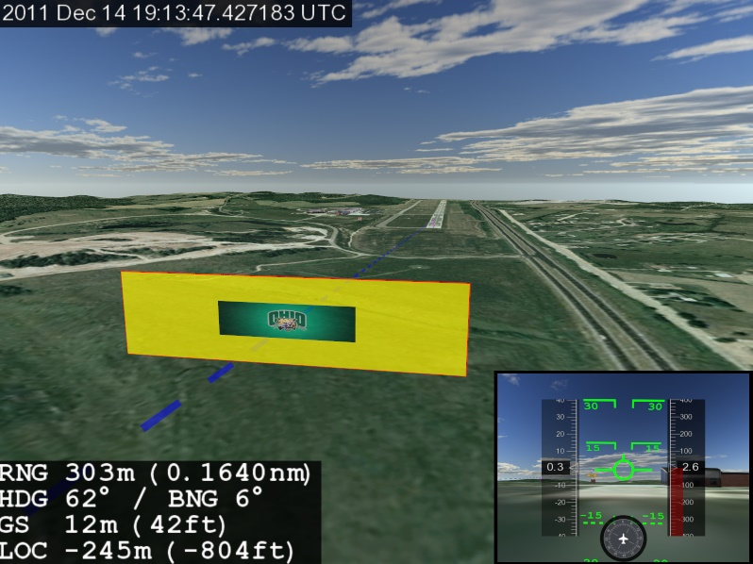
Virtual Worlds naturally map to 3D geospatial information.

Slide 5
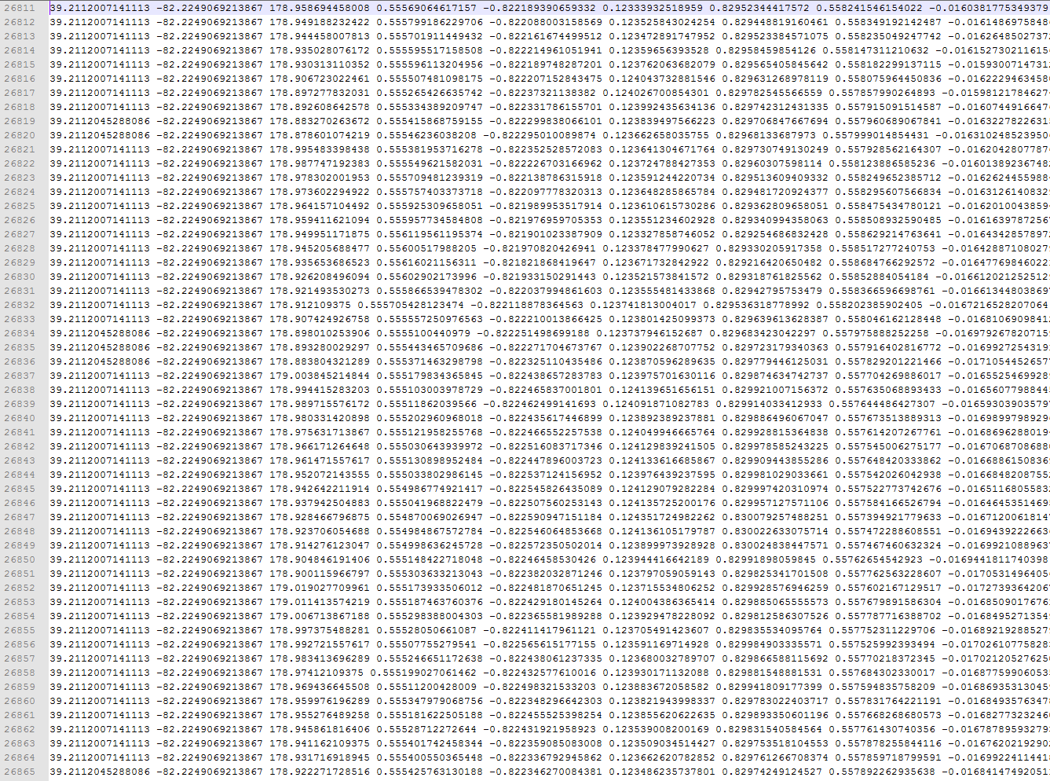
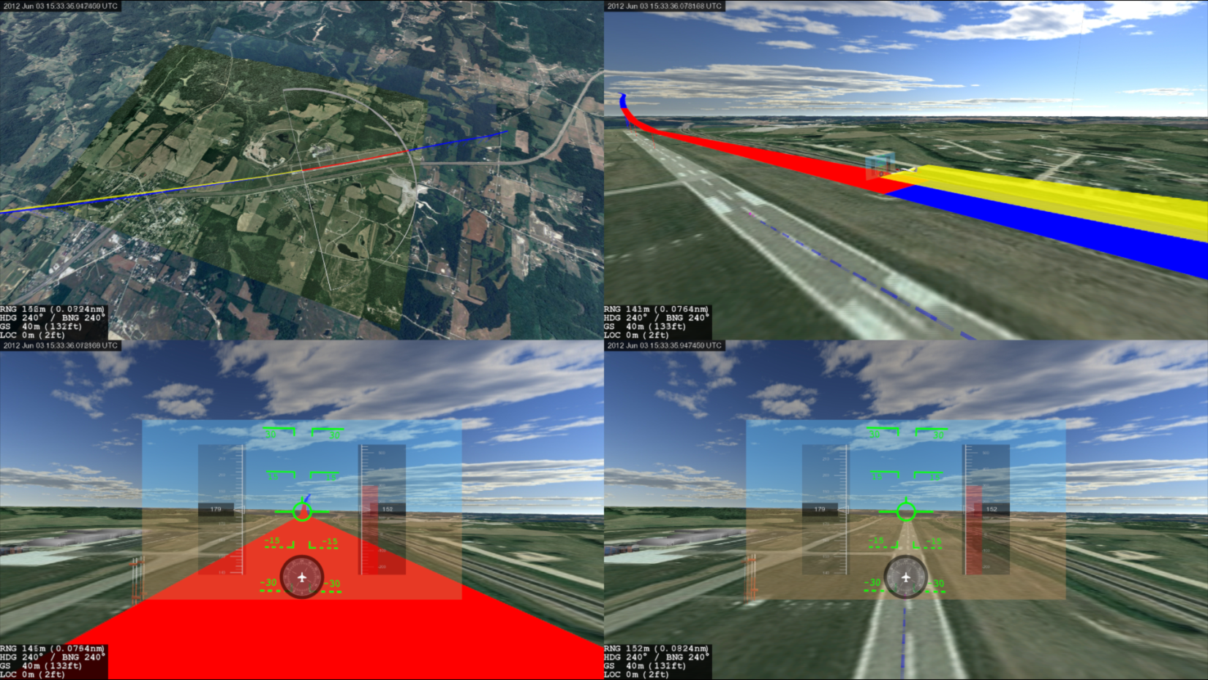
Humans Perceive Data Visually
Notes:
o Sensor data in not in a “human format”.
o Russian rocket launch (Proton-M ) July 2, 2013
o how do we turn disparate, non-uniform data from sensors and databases into a “living” 3D world?

Slide 6
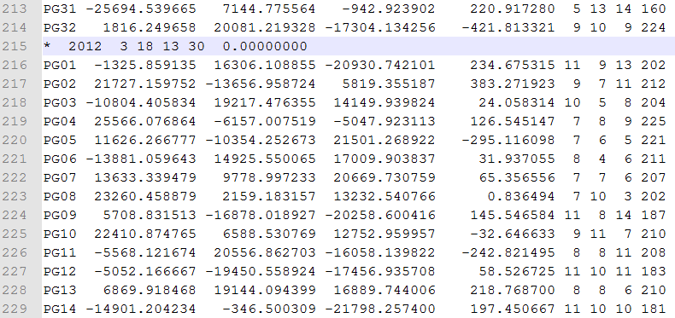
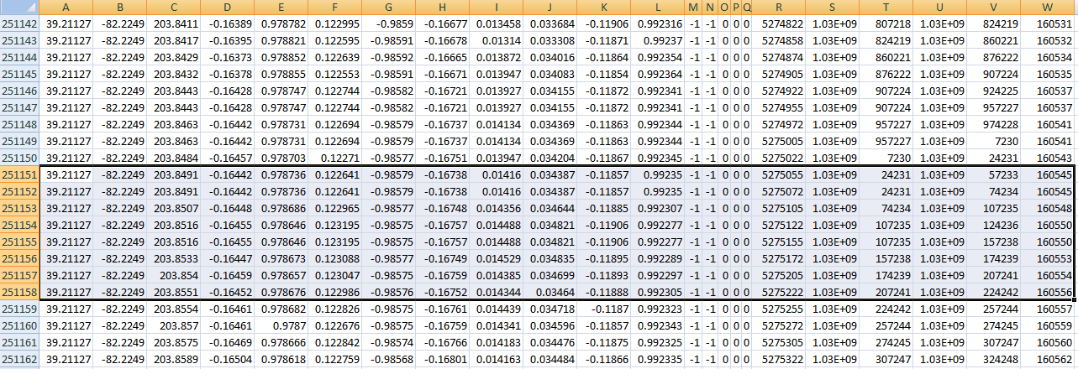
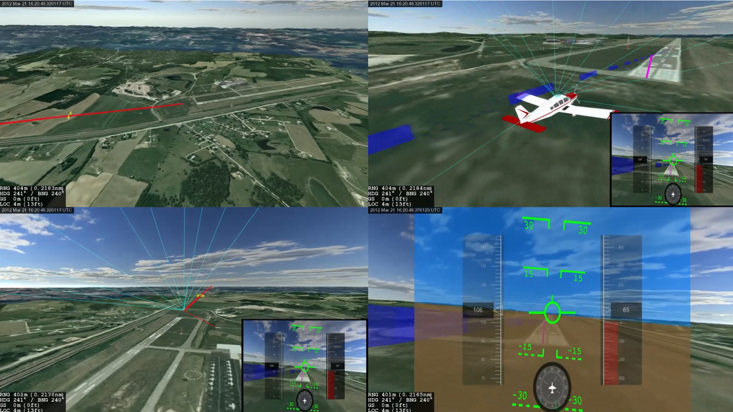
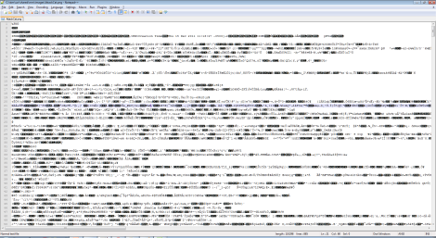
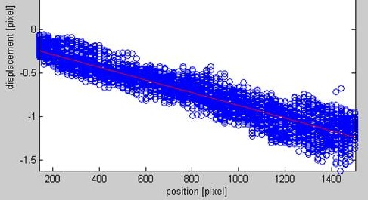
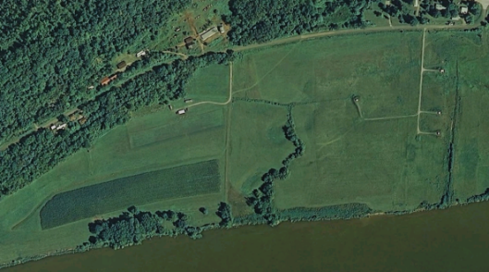
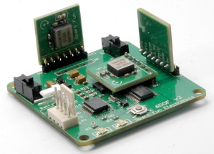
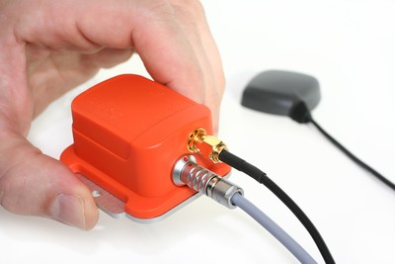
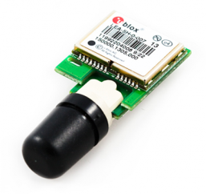
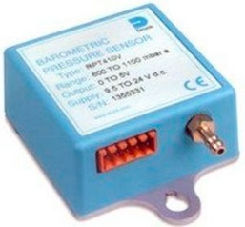
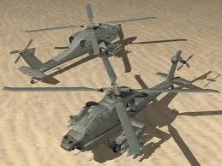
Unification of Sensor Fusion
Disparate, non-uniform inputs → Coherent, naturally understandable virtual world, real-time updates
3D World
Notes:
o humans naturally perceive a 3D world that changes over time
o most data we have is not conveyed in this way
o need to be domain expert to comprehend sensor output
o Leverage power of human 3D visual system using 3D Virtual Worlds

Slide 7
Video – Virt World mirror Real World, in Real Time
Affine RT Link.mp4
Reduce Bandwidth
Leverage a-priori information
New abilities possible w/ common frame & viz (sat LOS intuition)

Slide 8
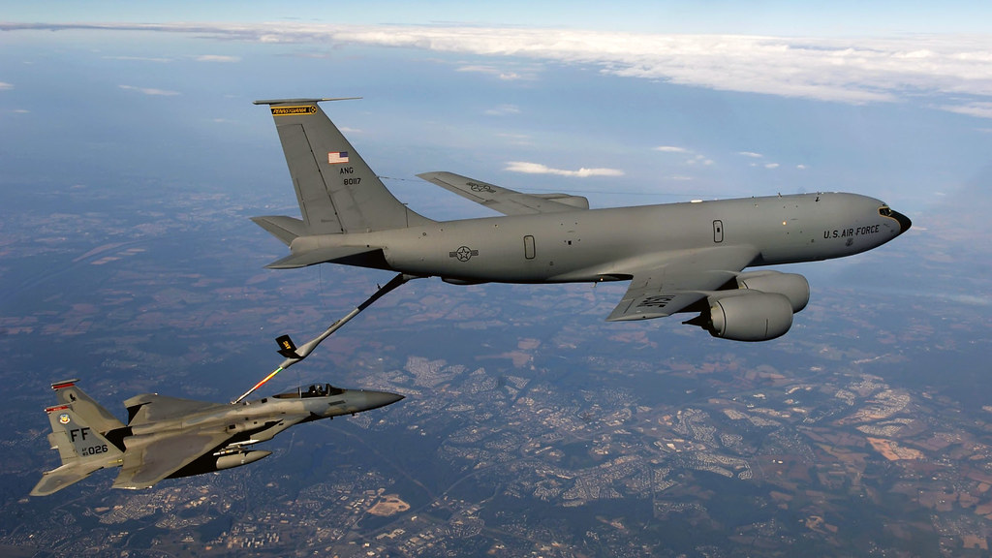
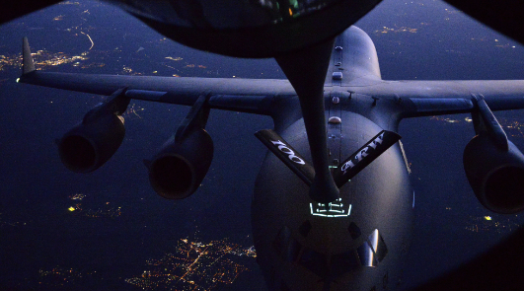
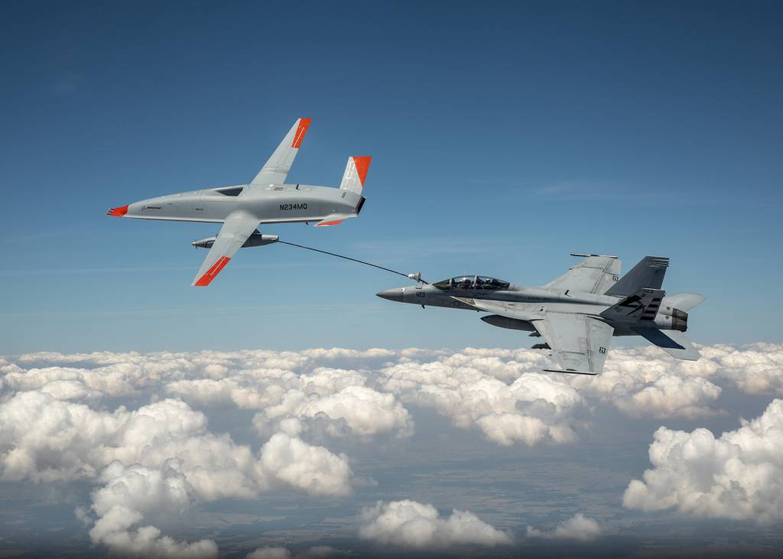
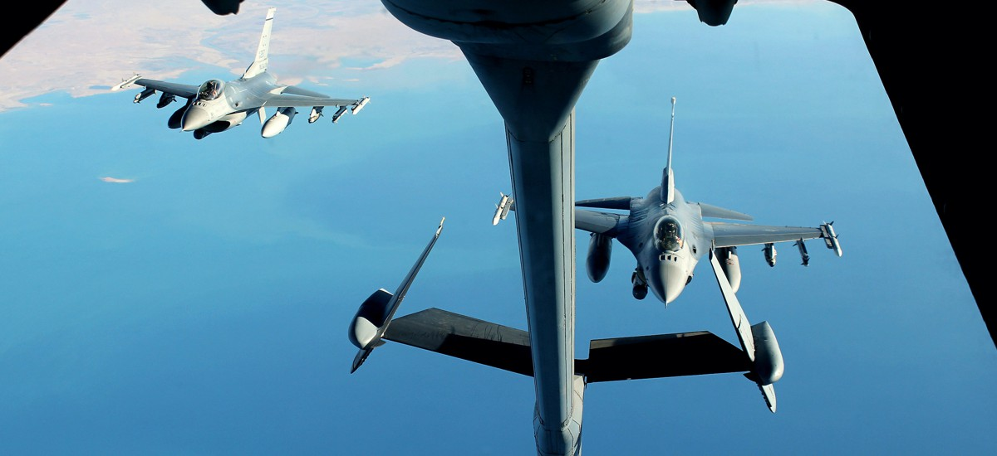

Slide 9
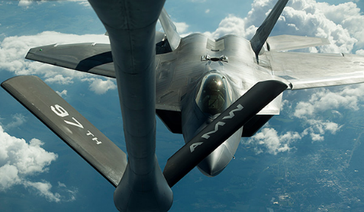
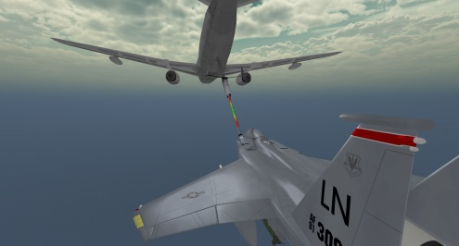
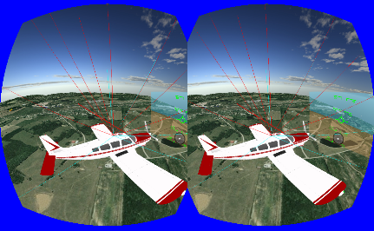



Automated Aerial Refueling
Relative Positioning using Stereo Vision
GPS-Denied Environments

Slide 10





Slide 11


Slide 12
How does one automate Aerial Refueling?

Slide 13

Receiver
Vision Sensor / Grad student
Automated Aerial Refueling SOLVED???

Slide 14







Edwards AFB
2016, 2019

Slide 15


EO & LWIR
Flight Tests
$$$
Hard
Approximate

Slide 16

Stereo Vision –based RelNav
DEMO: Stereo Vision AAR

Slide 17

Video: ISVC 0:18, 2:50

Slide 18







Slide 19

Video: Miller 3:20, 4:10, 4:50

Slide 20

Video: Vicon Approach

Slide 21


Extrinsic Calibrations?
Bumped Cameras?
Occlusions?
Can we overcome these?
Monocular-based Visual RelNav Approach
  Convolutional Neural Networks (CNN)

