Slide 1
Chapter 9: Main Memory

Slide 2
Chapter 9: Memory Management
Background
Contiguous Memory Allocation
Paging
Structure of the Page Table
Swapping
Example: The Intel 32 and 64-bit Architectures
Example: ARMv8 Architecture

Slide 3
Background
CPU
MMU
Registers
Cache
Main Memory
Hard Disk
Virtual Memory
Storage Bus Interface
Hard Disk

Slide 4
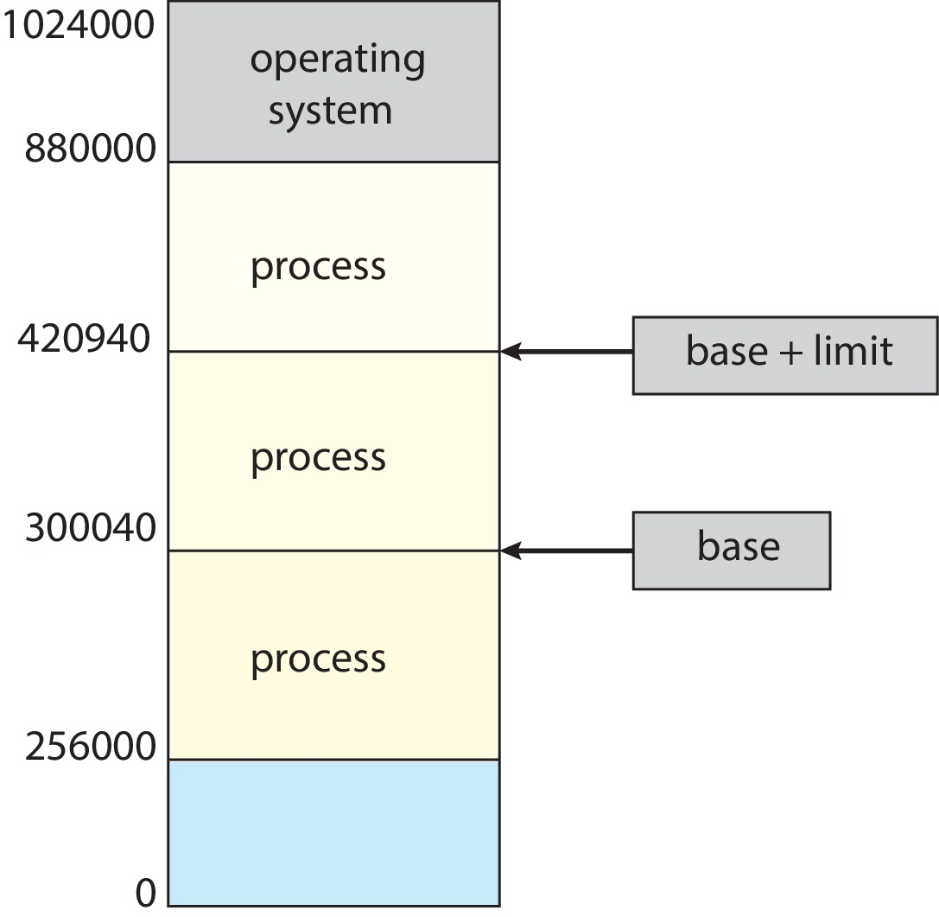
Process Memory

Slide 5
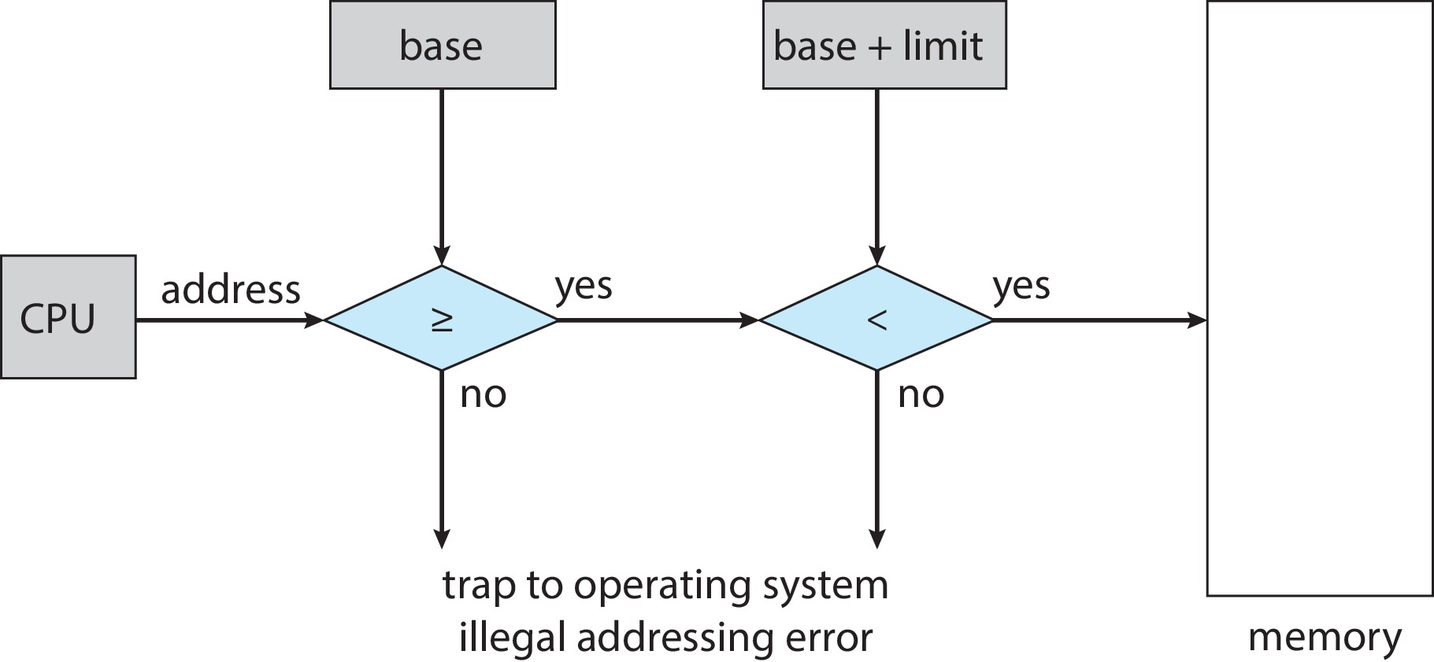
Hardware Address Protection
CPU must check every memory access generated in user mode to be sure it is between base and limit for that user
the instructions to loading the base and limit registers are privileged

Slide 6
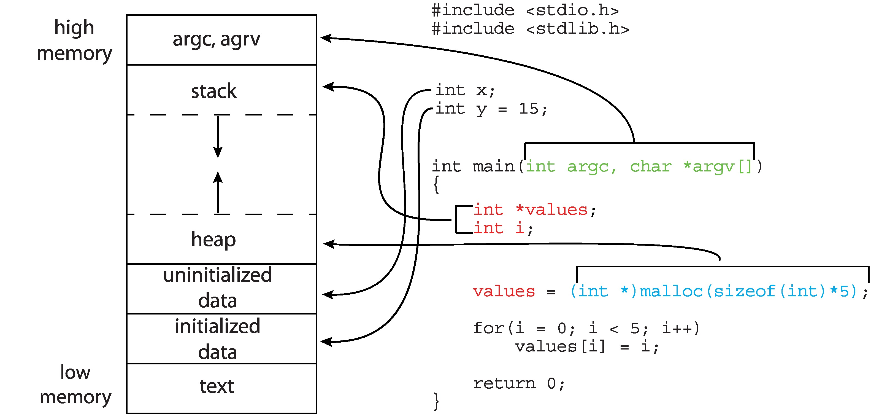
Relative or Absolute addresses

Slide 7
Memory Management
P1
P2
P4
Main Memory
P3

Slide 8
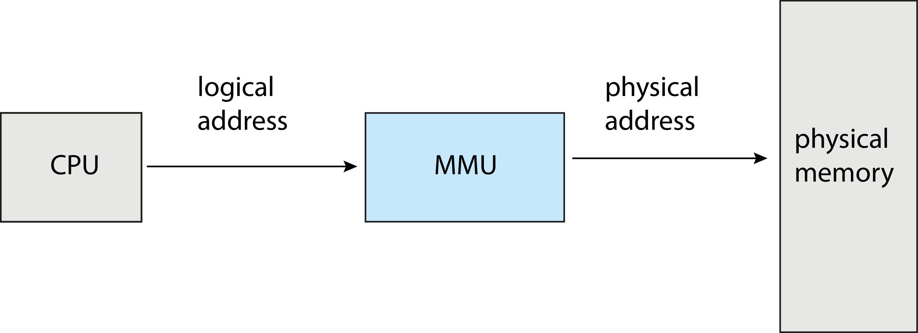
Memory-Management Unit (MMU)
Hardware device that at run time maps virtual to physical address
Many methods possible, covered in the rest of this chapter

Slide 9
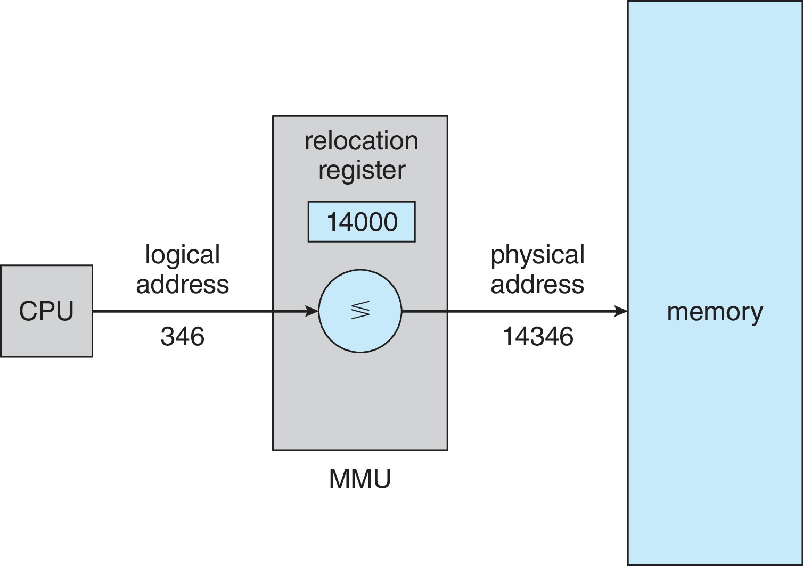
Memory-Management Unit (Cont.)

Slide 10
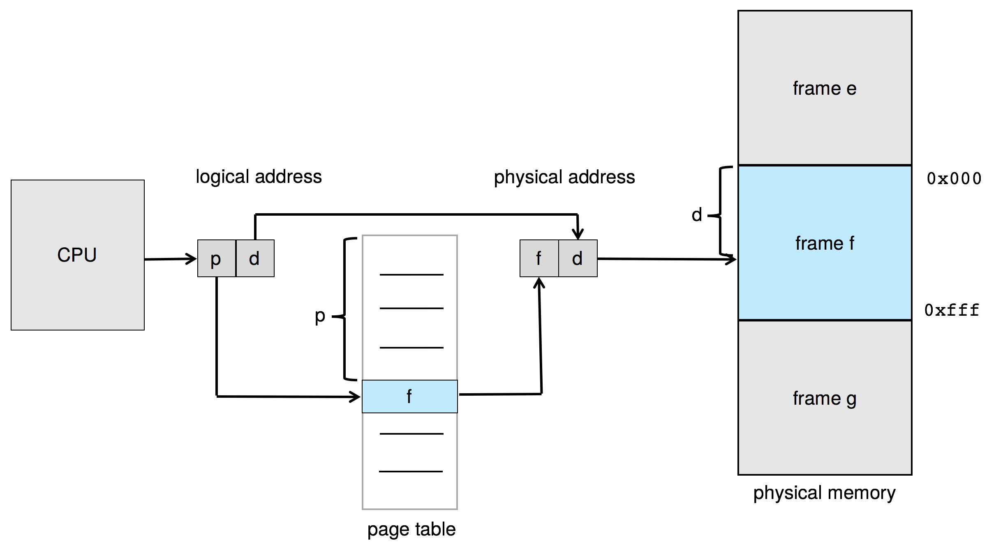
Paging Hardware

Slide 11
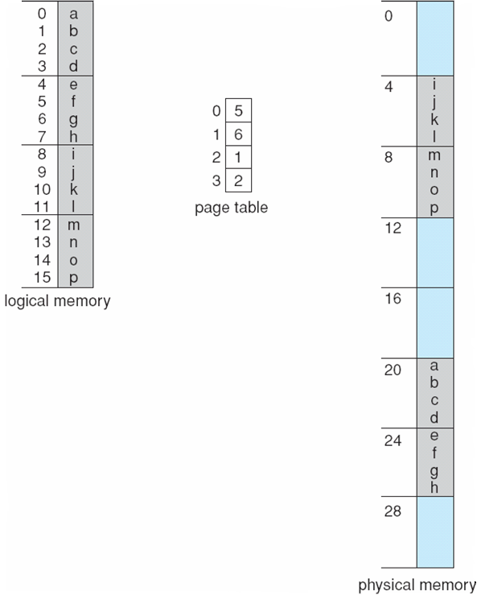
Paging Example
Logical address: n = 2 and m = 4. Using a page size of 4 bytes and a physical memory of 32 bytes (8 pages)
Page Table
00
01
10
11

Slide 12
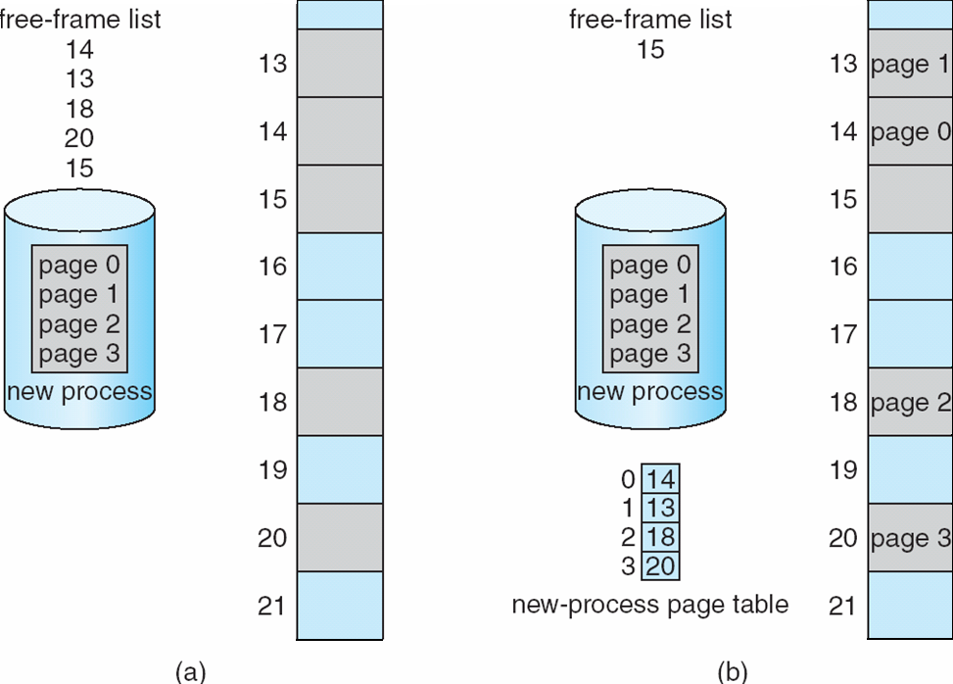
Free Frames
Before allocation
After allocation

Slide 13
Structure of the Page Table
Fragmentation
32 Bit architecture – page size 4 KB (common) = 1 million entries

Slide 14
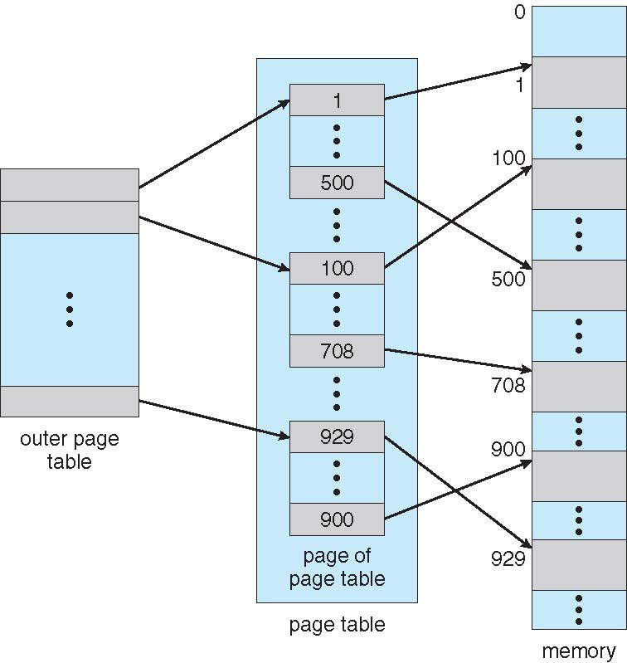
Hierarchical Page Tables
01101001 =
01
10
1001

Slide 15
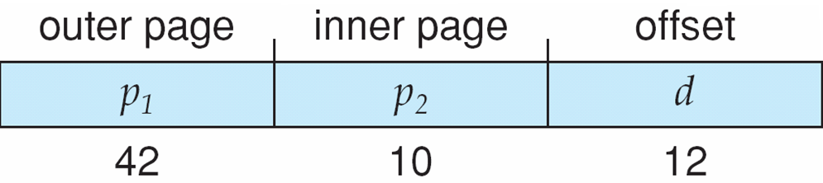
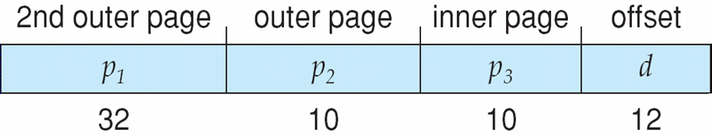
Three-level Paging Scheme
4.3 TB

Slide 16
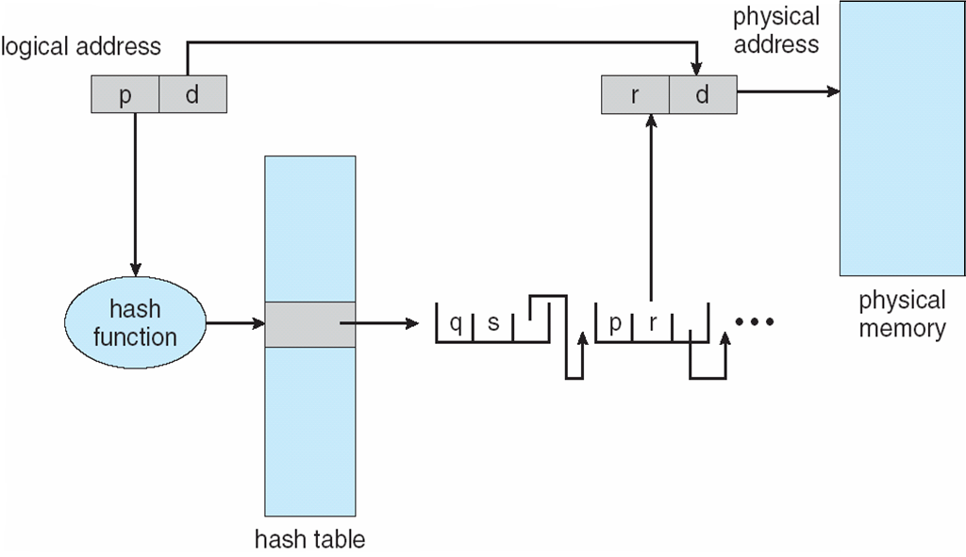
Hashed Page Table

Slide 17
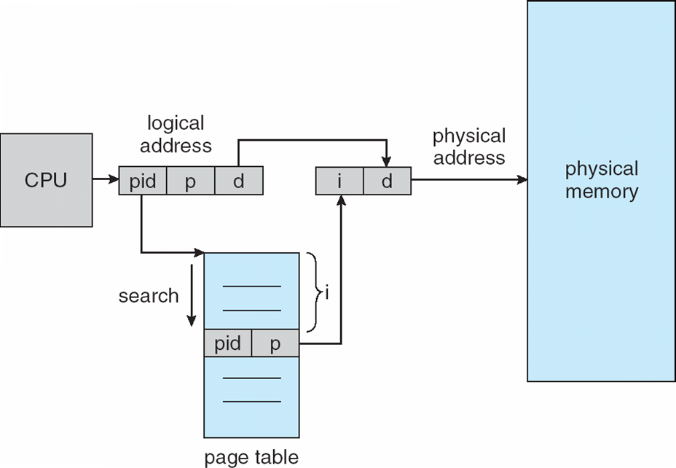
Inverted Page Table Architecture

Slide 18
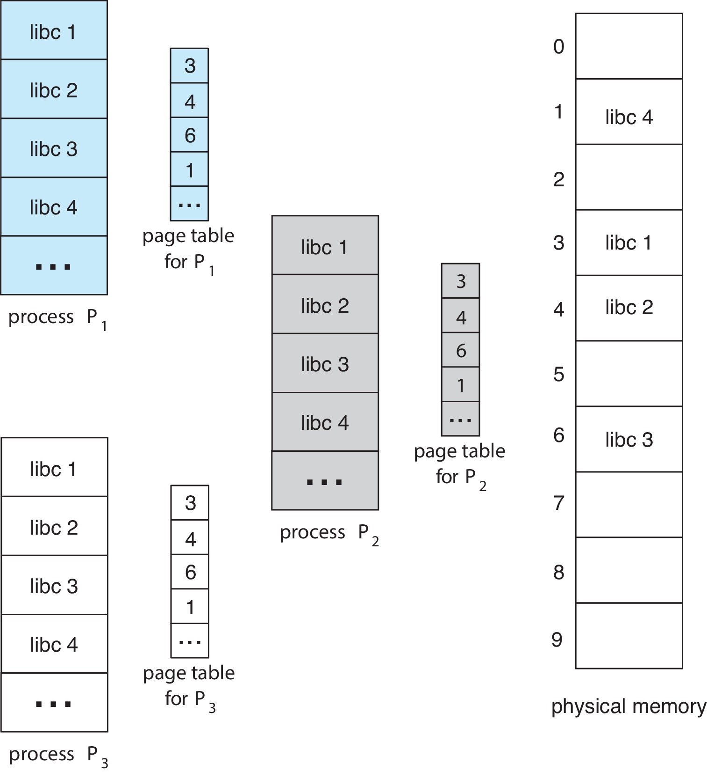
Shared Pages Example

Slide 19
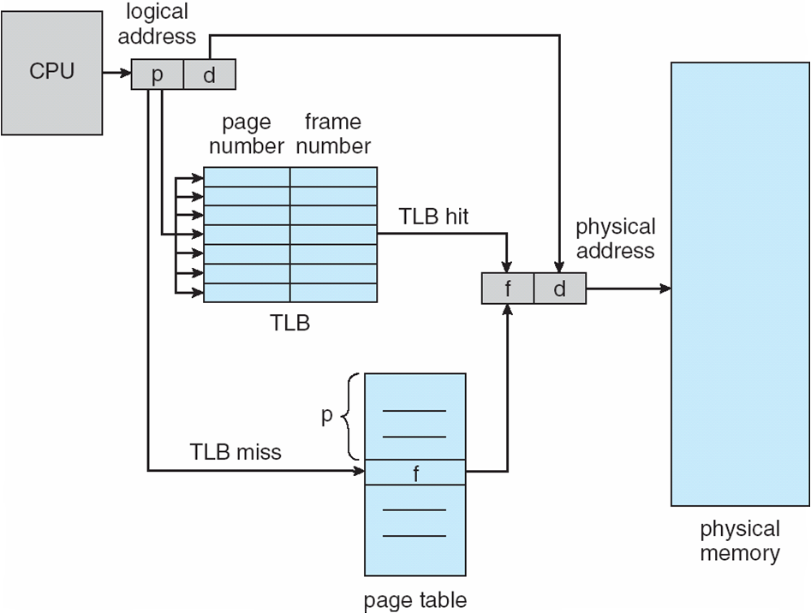
Paging Hardware With TLB

Slide 20
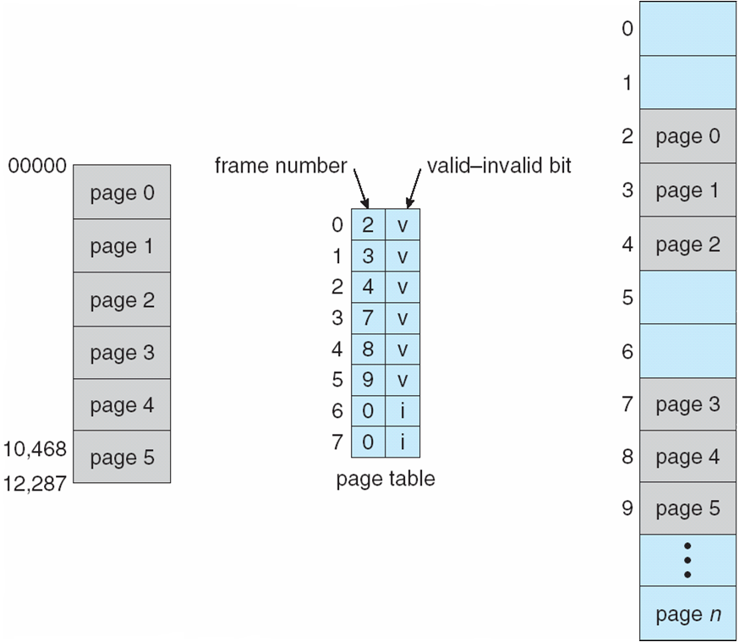
Valid (v) or Invalid (i) Bit In A Page Table

Slide 21
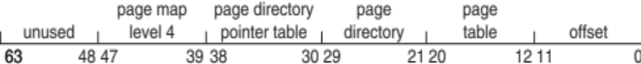
Intel x86-64
Current generation Intel x86 architecture
64 bits is ginormous (> 16 exabytes)
In practice only implement 48 bit addressing
  Page sizes of 4 KB, 2 MB, 1 GB
  Four levels of paging hierarchy
Can also use PAE so virtual addresses are 48 bits and physical addresses are 52 bits

Slide 22
End of Chapter 9

