Slide 1
Chapter 8: Deadlocks

Slide 2
Outline
System Model
Deadlock Characterization
Methods for Handling Deadlocks
Deadlock Prevention
Deadlock Avoidance
Deadlock Detection
Recovery from Deadlock

Slide 3
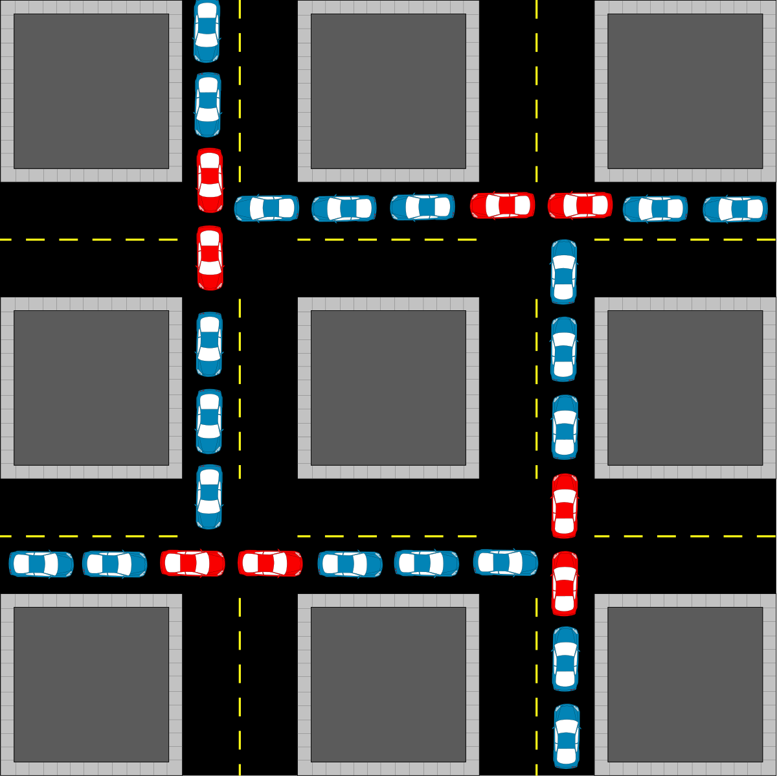
Deadlock (Gridlock)

Slide 4
Resource Allocation Graph
R₁
R₃
T₁
T₂
T₃
R₂
R₄

Slide 5
Conditions for Deadlock
Conditions for Deadlock:
Mutual exclusion
Hold and wait
No preemption
Circular wait
R₁
R₃
T₁
T₂
T₃
R₂
R₄

Slide 6
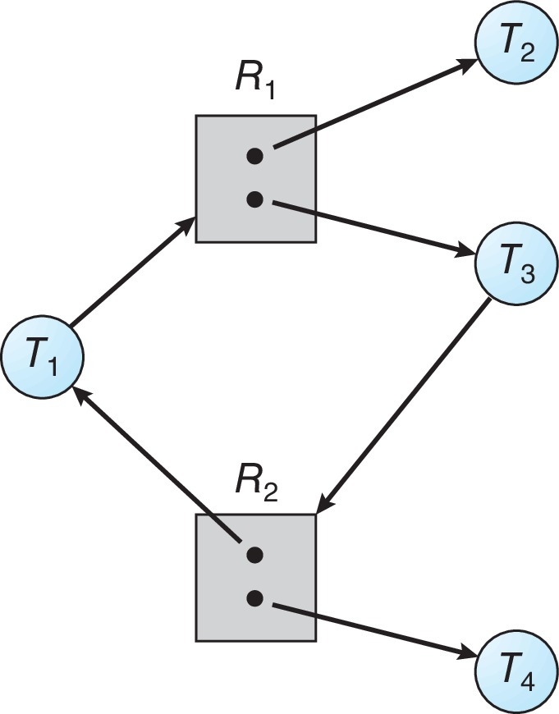
Graph with a Cycle But no Deadlock

Slide 7
Deadlock Prevention
Invalidate one of the four necessary conditions for deadlock:
Mutual Exclusion
Hold and Wait

Slide 8
Deadlock Prevention
Invalidate one of the four necessary conditions for deadlock:
R₁
R₃
Mutual Exclusion
Hold and Wait
No Preemption
T₁
T₂
T₃
R₂
R₄

Slide 9
Deadlock Prevention
Invalidate one of the four necessary conditions for deadlock:
Mutual Exclusion
Hold and Wait
No Preemption
Circular Wait
first_mutex = 1
second_mutex = 5

Slide 10
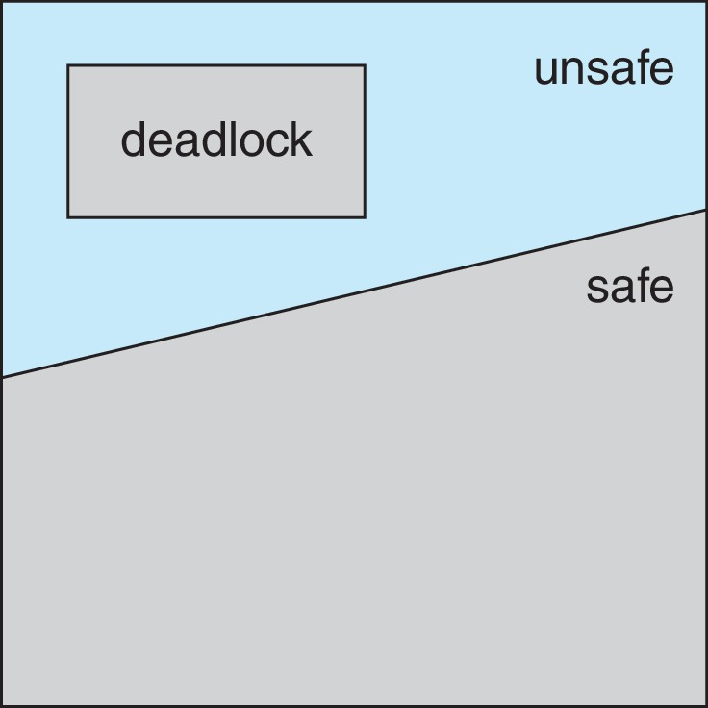
Deadlock Avoidance

Slide 11
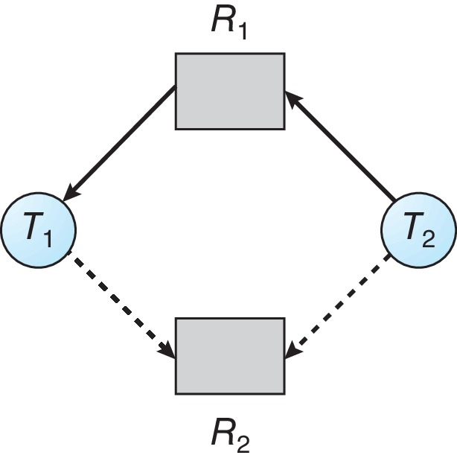
Resource-Allocation Graph

Slide 12
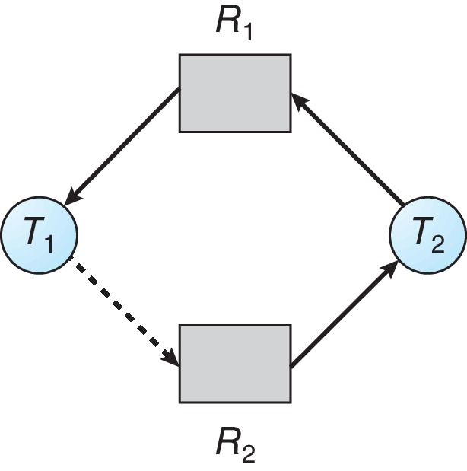
Unsafe State In Resource-Allocation Graph

Slide 13
Data Structures for the Banker’s Algorithm
Let n = number of processes, and m = number of resources types.
Snapshot at time T₀:
Allocation Max Available
A B C A B C A B C
P₀ 0 1 0 7 5 3 3 3 2
P₁ 2 0 0 3 2 2
P₂ 3 0 2 9 0 2
P₃ 2 1 1 2 2 2
P₄ 0 0 2 4 3 3

Slide 14
Banker’s Algorithms Explained
Safety Algorithm
Resource Request Algorithm
Watch the Banker’s Algorithm Video

Slide 15
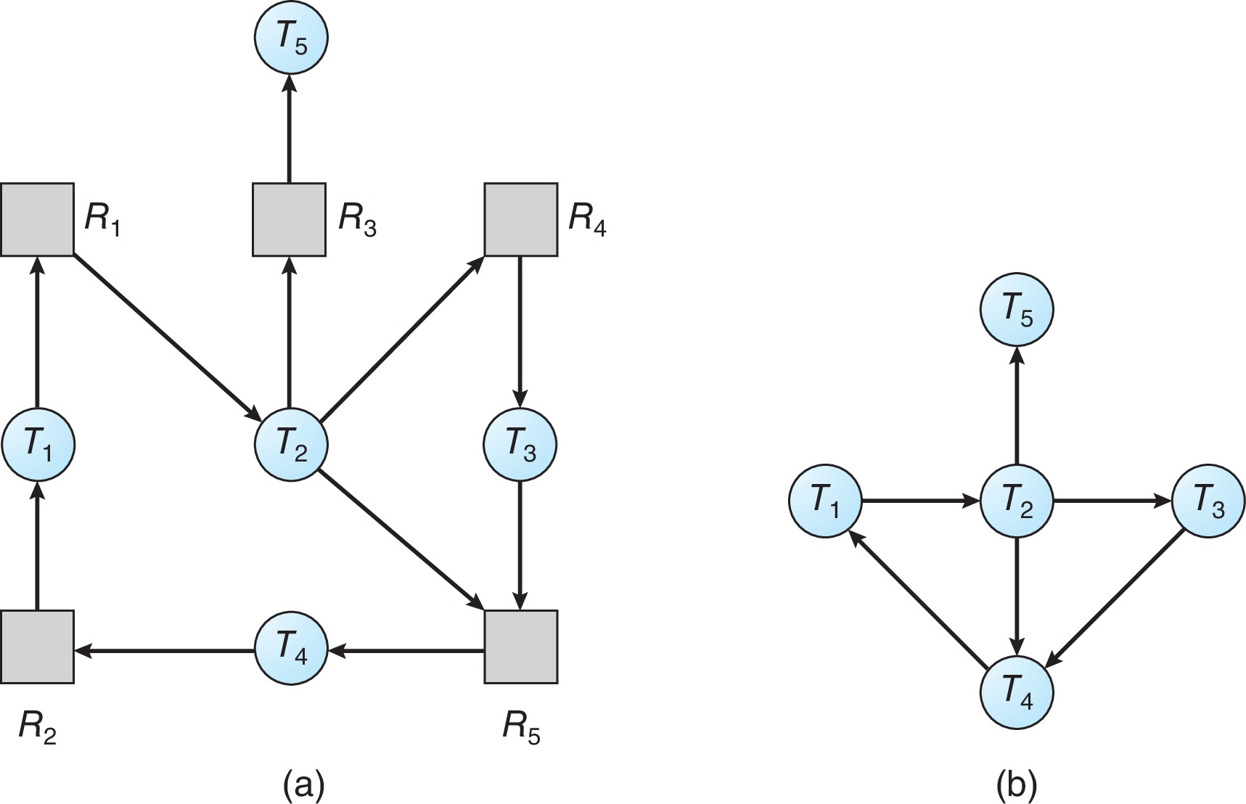
Resource-Allocation Graph and Wait-for Graph
Resource-Allocation Graph
Corresponding wait-for graph

Slide 16
Example of Detection Algorithm
Five processes P₀ through P₄; three resource types
A (7 instances), B (2 instances), and C (6 instances)
Snapshot at time T₀:
Allocation Request Available
A B C A B C A B C
P₀ 0 1 0 0 0 0 0 0 0
P₁ 2 0 0 2 0 2
P₂ 3 0 3 0 0 0
P₃ 2 1 1 1 0 0
P₄ 0 0 2 0 0 2
Sequence <P₀, P₂, P₃, P₁, P₄> will result in Finish[i] = true for all i

Slide 17
Recovery from Deadlock
In which order should we choose to abort?
  Priority of the process
  How long process has computed, and how much longer to completion
  Resources the process has used
  Resources process needs to complete
  How many processes will need to be terminated
  Is process interactive or batch?
Selecting a victim – minimize cost
Rollback – return to some safe state, restart process for that state
Starvation – same process may always be picked as victim, include number of rollback in cost factor

Slide 18
End of Chapter 8

